Slide 1



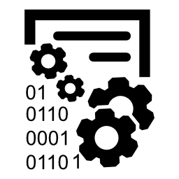


Project delivery with KPMG-TrAction
Your portfolio (subsidiaries/divisions), your programmes and projects at a glance
KPMG-Cloud for fast, secure and mobile access to project data
One system for project planning, management as well as cost and effect tracking
One platform for status reporting, decision making and risk management
Status reports on a click, data import and export, project documentation
Easy transfer of best practice to other divisions or locations
Minimal training need - 1h online training for project members

